Slide 1
Tool for configuration of coordinated cache and bank coloring
Bjorn Andersson

Slide 2
Copyright 2021 Carnegie Mellon University.
This material is based upon work funded and supported by the Department of Defense under Contract No. FA8702-15-D-0002 with Carnegie Mellon University for the operation of the Software Engineering Institute, a federally funded research and development center.
The view, opinions, and/or findings contained in this material are those of the author(s) and should not be construed as an official Government position, policy, or decision, unless designated by other documentation.
NO WARRANTY. THIS CARNEGIE MELLON UNIVERSITY AND SOFTWARE ENGINEERING INSTITUTE MATERIAL IS FURNISHED ON AN "AS-IS" BASIS. CARNEGIE MELLON UNIVERSITY MAKES NO WARRANTIES OF ANY KIND, EITHER EXPRESSED OR IMPLIED, AS TO ANY MATTER INCLUDING, BUT NOT LIMITED TO, WARRANTY OF FITNESS FOR PURPOSE OR MERCHANTABILITY, EXCLUSIVITY, OR RESULTS OBTAINED FROM USE OF THE MATERIAL. CARNEGIE MELLON UNIVERSITY DOES NOT MAKE ANY WARRANTY OF ANY KIND WITH RESPECT TO FREEDOM FROM PATENT, TRADEMARK, OR COPYRIGHT INFRINGEMENT.
[DISTRIBUTION STATEMENT A] This material has been approved for public release and unlimited distribution. Please see Copyright notice for non-US Government use and distribution.
This material may be reproduced in its entirety, without modification, and freely distributed in written or electronic form without requesting formal permission. Permission is required for any other use. Requests for permission should be directed to the Software Engineering Institute at permission@sei.cmu.edu.
DM21-0235

Slide 3
Background: * About multicore. Multicore processors are the norm today. This has been the case in desktop and laptop computers for 15 years. This has been the case for mobile computing for 10 years. In DoD, for non-safety-critical systems, multicore system have started to be used. In DoD, for safety-critical systems, multicores (with all cores enabled) are currently not used but there is great interest in finding ways to do so. * About multicore and timing. Multicore processors tend to have shared memory (both DRAM memory shared between processor cores and shared physical address space between processor cores). There are also many resources that aim to speed up execution (e.g., cache) and there are resources for connecting processor cores to memory (e.g., memory bus). On a higher level, one can say that there are resources in the memory system that are shared between processor cores and hence they may be shared between processes/threads on different processor cores. For some of these resources, it holds that the resource can only be used by one thread/process at a time (e.g., memory bus). For other resources, it holds that the use of one resource by one thread causes another thread later to execute more slowly (e.g., cache eviction). * Mechanism. The SEI has developed a technique called coordinated cache and bank coloring. See N. Suzuki et al., “Coordinated bank and cache coloring for temporal protection of memory accesses,” ICESS 2013. This technique involves changing the virtual memory manager in the operating system. It also involves deciding how the virtual memory manager should work; we call it configuration. This slide deck presents the tool for configuration.

Slide 4
* The advantages of the mechanism. For a mechanism, two properties are desirable: 1. Providing timing isolation with respect to both cache and bank. 2. Requiring only the use of the virtual memory system (i.e., not depend on instructions or features that are available in only few processors). This is important for systems that may have long life-time (decades). As far as we know, coordinated cache and bank coloring is the only technique that offers these two properties. (there are other techniques for cache coloring but they do not achieve bank coloring; there are techniques for bank coloring but they do not achieve cache coloring; there are techniques that use cache locking but this requires special instructions). * The disadvantages of the mechanism: 1. Since it requires changing the behavior of the virtual memory system, it requires changing the operating system. 2. May require that at most a fraction of the available physical memory is used. There are ways to alleviate these drawbacks. For example, for the former, it is sometimes possible to use kernel modules. For the latter, one can distinguish hard and soft real-time and take advantage of that.

Slide 5
What the configuration tool does
Model of the system
Task 1
Task 2
Task 3
Processor 1
Processor 2

Slide 6
What the configuration tool does
Model of the system
Task 1
T₁
C₁¹ C₁² C₁³ C₁⁴ C₁⁵ …
Task 2
T₂
C₂¹ C₂² C₂³ C₂⁴ C₂⁵ …
Task 3
T₃
C₃¹ C₃² C₃³ C₃⁴ C₃⁵ …
Processor 1
Processor 2
H
B

Slide 7
What the configuration tool does
Model of the system
Task 1
T₁
C₁¹ C₁² C₁³ C₁⁴ C₁⁵ …
Task 2
Period of task 1
T₂
C₂¹ C₂² C₂³ C₂⁴ C₂⁵ …
Task 3
Period of task 2
T₃
C₃¹ C₃² C₃³ C₃⁴ C₃⁵ …
Processor 1
Period of task 3
Processor 2
H
B

Slide 8
What the configuration tool does
Model of the system
Task 1
T₁
C₁¹ C₁² C₁³ C₁⁴ C₁⁵ …
Task 2
Execution time of task 1 if it is assigned 2 cache colors
T₂
C₂¹ C₂² C₂³ C₂⁴ C₂⁵ …
Execution time of task 1 if it is assigned 1 cache color
Task 3
T₃
C₃¹ C₃² C₃³ C₃⁴ C₃⁵ …
Processor 1
Processor 2
H
B

Slide 9
What the configuration tool does
Model of the system
Task 1
T₁
C₁¹ C₁² C₁³ C₁⁴ C₁⁵ …
Task 2
Execution time of task 1 if it is assigned 4 cache colors
T₂
C₂¹ C₂² C₂³ C₂⁴ C₂⁵ …
Execution time of task 1 if it is assigned 3 cache colors
Task 3
T₃
C₃¹ C₃² C₃³ C₃⁴ C₃⁵ …
Processor 1
Processor 2
H
B

Slide 10
What the configuration tool does
Model of the system
Task 1
T₁
C₁¹ C₁² C₁³ C₁⁴ C₁⁵ …
Task 2
Execution time of task 1 if it is assigned 5 cache colors
T₂
C₂¹ C₂² C₂³ C₂⁴ C₂⁵ …
Task 3
T₃
C₃¹ C₃² C₃³ C₃⁴ C₃⁵ …
Processor 1
Processor 2
H
B

Slide 11
What the configuration tool does
Model of the system
Task 1
T₁
C₁¹ C₁² C₁³ C₁⁴ C₁⁵ …
Task 2
T₂
C₂¹ C₂² C₂³ C₂⁴ C₂⁵ …
Task 3
Number of cache colors
T₃
C₃¹ C₃² C₃³ C₃⁴ C₃⁵ …
Number of bank colors
Processor 1
Processor 2
H
B

Slide 12
What the configuration tool does
Model of the system
Task 1
Configuration Tool
T₁
C₁¹ C₁² C₁³ C₁⁴ C₁⁵ …
input
output
Task 2
T₂
C₂¹ C₂² C₂³ C₂⁴ C₂⁵ …
Task 3
T₃
C₃¹ C₃² C₃³ C₃⁴ C₃⁵ …
Processor 1
Processor 2
H
B

Slide 13
What the configuration tool does
Model of the system
Task 1
Configuration Tool
Assignment of tasks to processors.
Assignment of number of cache colors to each task
T₁
C₁¹ C₁² C₁³ C₁⁴ C₁⁵ …
input
output
Task 2
T₂
C₂¹ C₂² C₂³ C₂⁴ C₂⁵ …
Task 3
T₃
C₃¹ C₃² C₃³ C₃⁴ C₃⁵ …
Processor 1
Processor 2
H
B

Slide 14
What the configuration tool does
Model of the system
Task 1
Configuration Tool
Assignment of tasks to processors.
Assignment of number of cache colors to each task
T₁
C₁¹ C₁² C₁³ C₁⁴ C₁⁵ …
input
output
Task 2
T₂
C₂¹ C₂² C₂³ C₂⁴ C₂⁵ …
Task 3
T₃
C₃¹ C₃² C₃³ C₃⁴ C₃⁵ …
Processor 1
Operating system that supports coordinate cache and bank coloring (e.g., SEI’s Linux patch)
Processor 2
H
B

Slide 15
Understanding the constraints on configuration
Consider a computer system with 4 cache colors and 4 bank colors and two tasks τ₁ and τ₂.
The physical memory consists of 16 cells.
Assume task 1 and task 2 are assigned to the same processor, processor 1.
Cache color
0
1
2
3
0
1
Bank color
2
3

Slide 16
Understanding the constraints on configuration
Consider a computer system with 4 cache colors and 4 bank colors and two tasks τ₁ and τ₂.
The physical memory consists of 16 cells.
Assume task 1 and task 2 are assigned to the same processor, processor 1.
Cache color
0
1
2
3
0
1
Bank color
2
Task 2
Task 1
Task 1
3

Slide 17
Understanding the constraints on configuration
Consider a computer system with 4 cache colors and 4 bank colors and two tasks τ₁ and τ₂.
The physical memory consists of 16 cells.
Assume task 1 and task 2 are assigned to the same processor, processor 1.
Cache color
0
1
2
3
Note that task 1 and task 2 do not share cache colors.
0
1
Bank color
2
Task 2
Task 1
Task 1
3

Slide 18
Understanding the constraints on configuration
Consider a computer system with 4 cache colors and 4 bank colors and two tasks τ₁ and τ₂.
The physical memory consists of 16 cells.
Assume task 1 and task 2 are assigned to the same processor, processor 1.
Cache color
0
1
2
3
Note that task 1 and task 2 share bank colors.
But this is OK because they are assigned to the same processor.
0
1
Bank color
2
Task 2
Task 1
Task 1
3

Slide 19
Understanding the constraints on configuration
Consider a computer system with 4 cache colors and 4 bank colors and two tasks τ₁ and τ₂.
The physical memory consists of 16 cells.
Assume task 1 and task 2 are assigned to different processors, processor 1 and processor 2 respectively.
Cache color
0
1
2
3
0
1
Bank color
2
3

Slide 20
Understanding the constraints on configuration
Consider a computer system with 4 cache colors and 4 bank colors and two tasks τ₁ and τ₂.
The physical memory consists of 16 cells.
Assume task 1 and task 2 are assigned to different processors, processor 1 and processor 2 respectively.
Cache color
0
1
2
3
0
1
Task 2
Bank color
2
Task 1
Task 1
3

Slide 21
Understanding the constraints on configuration
Consider a computer system with 4 cache colors and 4 bank colors and two tasks τ₁ and τ₂.
The physical memory consists of 16 cells.
Assume task 1 and task 2 are assigned to different processors, processor 1 and processor 2 respectively.
Cache color
0
1
2
3
Note that task 1 and task 2 are assigned to different cache colors
and bank colors.
Since task 1 and task 2 are assigned to different processors, they must use different bank colors.
0
1
Task 2
Bank color
2
Task 1
Task 1
3

Slide 22
The figure on previous slide shows a concrete allocation. We will however create an abstract allocation which can then be converted to a concrete allocation. The next slide shows an abstract allocation.

Slide 23
Assume task 1 and task 2 are assigned to processor 1 and task 3, task 4, and task 5 are assigned to processor 2.
Allocated to task
1
2
3
4
5
Cache color
0
1
2
3
4
5
6
7
1
0
1
2
Allocated to processor
3
Bank color
2
4
5
6
7

Slide 24
Assume task 1 and task 2 are assigned to processor 1 and task 3, task 4, and task 5 are assigned to processor 2.
Allocated to task
1
2
3
4
5
Cache color
0
1
2
3
4
5
6
7
1
0
task 1
1
2
Allocated to processor
3
Bank color
2
4
5
6
7

Slide 25
Assume task 1 and task 2 are assigned to processor 1 and task 3, task 4, and task 5 are assigned to processor 2.
Allocated to task
1
2
3
4
5
Cache color
0
1
2
3
4
5
6
7
1
0
task 2
1
2
Allocated to processor
3
Bank color
2
4
5
6
7

Slide 26
Assume task 1 and task 2 are assigned to processor 1 and task 3, task 4, and task 5 are assigned to processor 2.
Allocated to task
1
2
3
4
5
Cache color
0
1
2
3
4
5
6
7
1
0
1
2
Allocated to processor
3
Bank color
2
4
task 3
5
6
7

Slide 27
Assume task 1 and task 2 are assigned to processor 1 and task 3, task 4, and task 5 are assigned to processor 2.
Allocated to task
1
2
3
4
5
Cache color
0
1
2
3
4
5
6
7
1
0
1
2
Allocated to processor
3
Bank color
2
4
task 4
5
6
7

Slide 28
Assume task 1 and task 2 are assigned to processor 1 and task 3, task 4, and task 5 are assigned to processor 2.
Allocated to task
1
2
3
4
5
Cache color
0
1
2
3
4
5
6
7
1
0
1
2
Allocated to processor
3
Bank color
2
4
task 5
5
6
7

Slide 29
Assume task 1 and task 2 are assigned to processor 1 and task 3, task 4, and task 5 are assigned to processor 2.
Allocated to task
1
2
3
4
5
Cache color
0
1
2
3
4
5
6
7
1
0
memory that is allocated
1
2
Allocated to processor
3
Bank color
2
4
memory that is allocated
5
6
7

Slide 30
Assume task 1 and task 2 are assigned to processor 1 and task 3, task 4, and task 5 are assigned to processor 2.
Allocated to task
1
2
3
4
5
Cache color
0
1
2
3
4
5
6
7
1
0
memory that is allocated
1
2
Allocated to processor
3
Bank color
2
4
memory that is allocated
5
Our coordinated cache and bank coloring
forces us to waste 50% of the memory
on a dual core system.
6
7

Slide 31
The configuration tool can be downloaded at http://www.andrew.cmu.edu/user/banderss/software/coordinated_cache_and_bank_coloring_configuration/completeisolation.c.

Slide 32
Let us now see some screenshot from the use of the tool

Slide 33
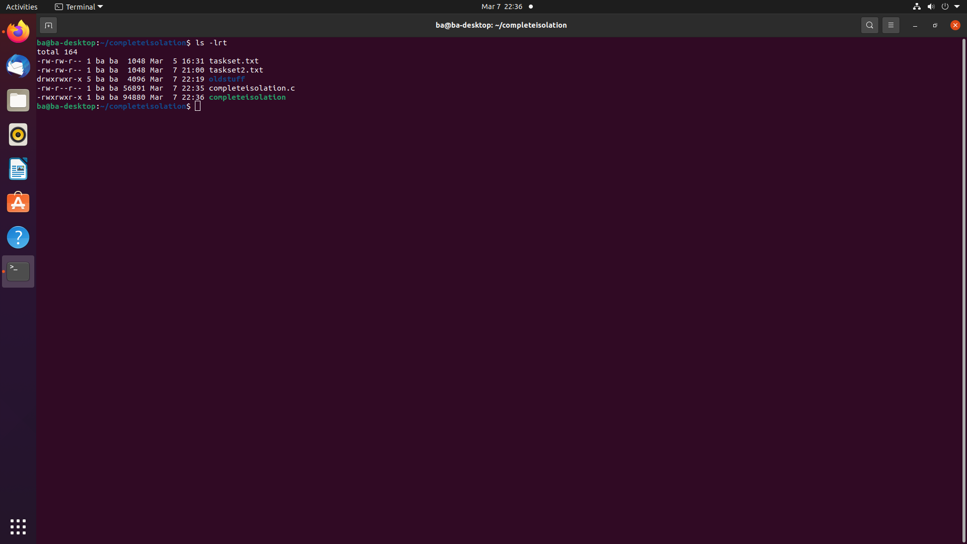

Slide 34
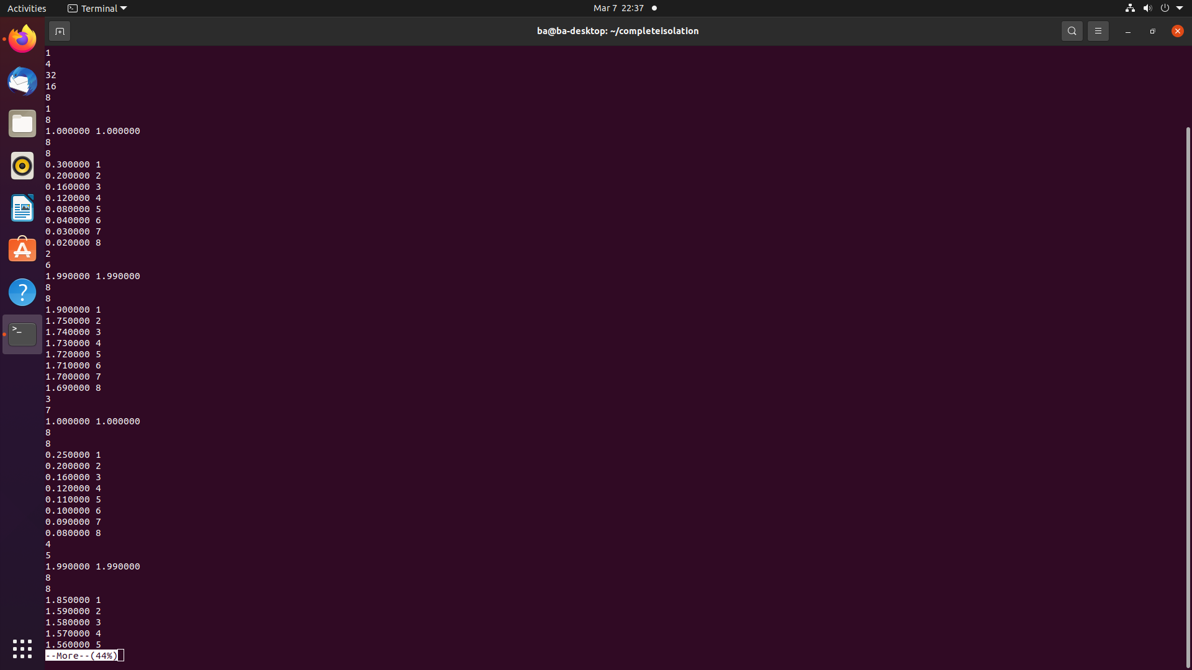

Slide 35
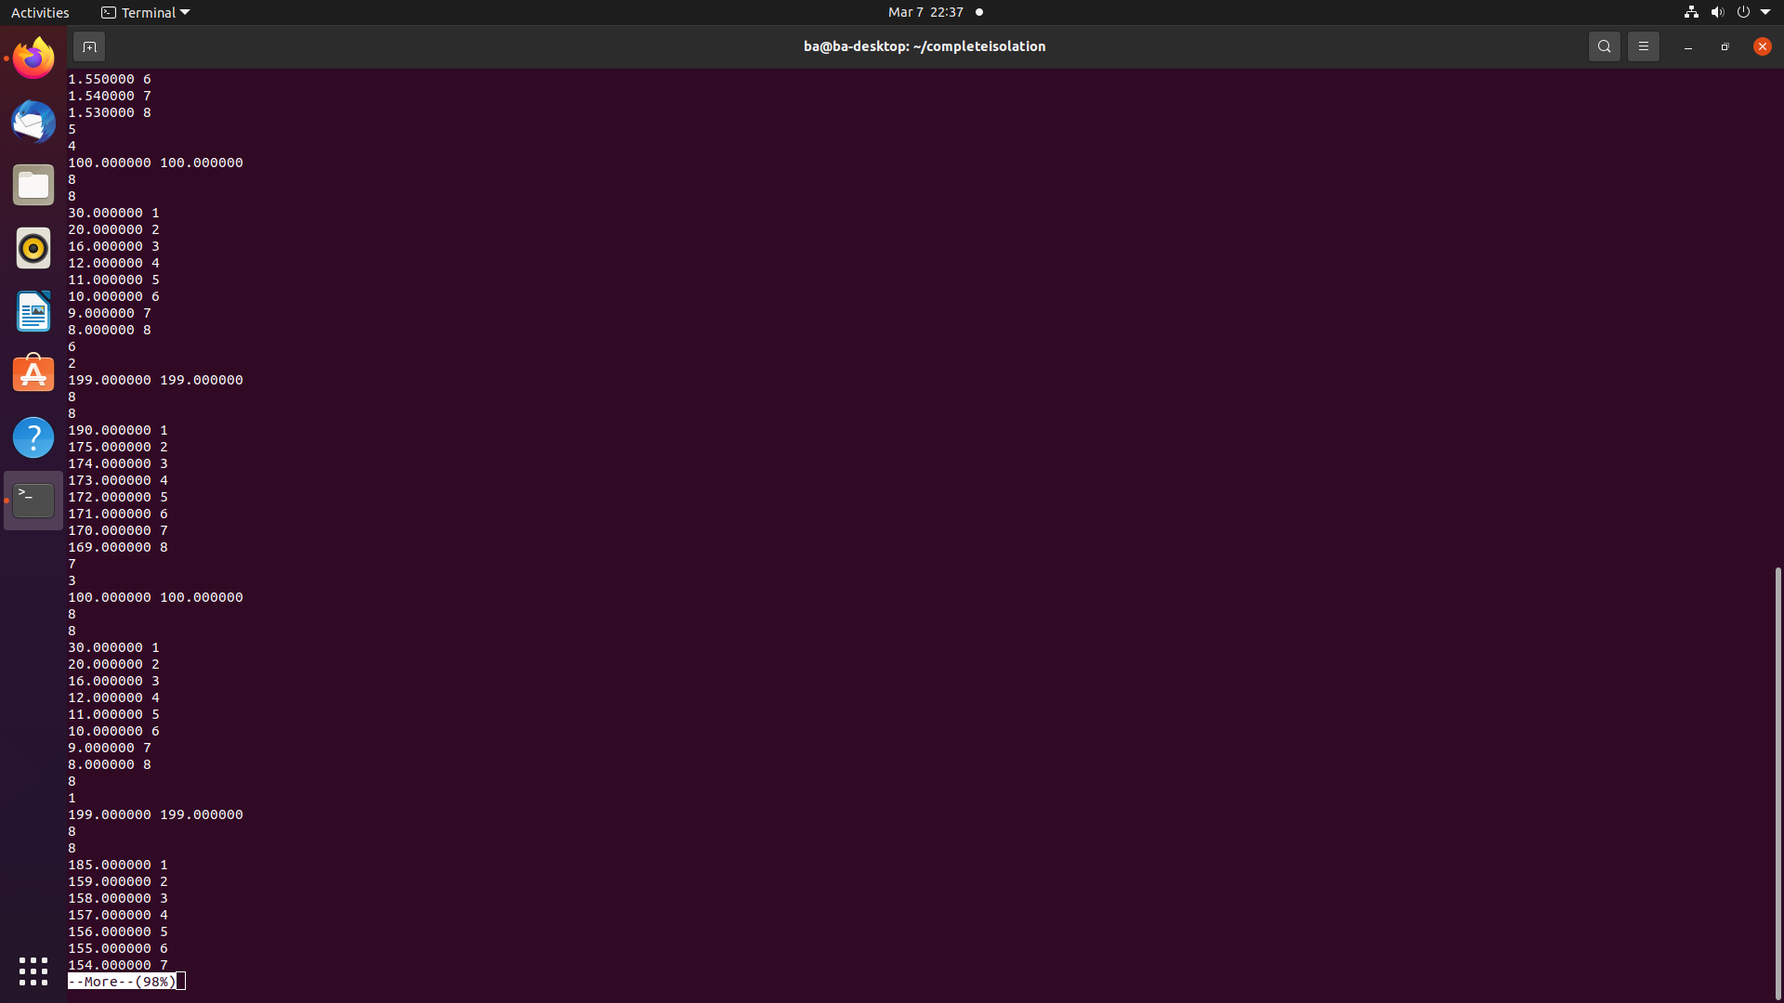

Slide 36
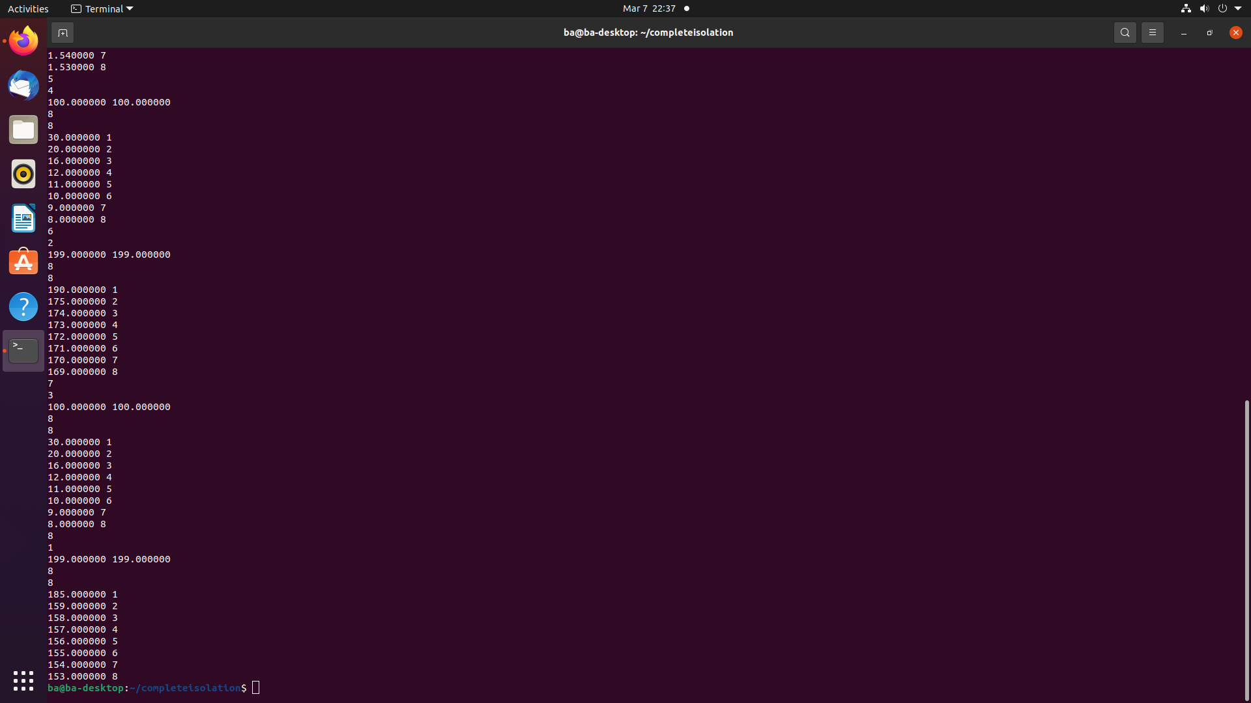

Slide 37
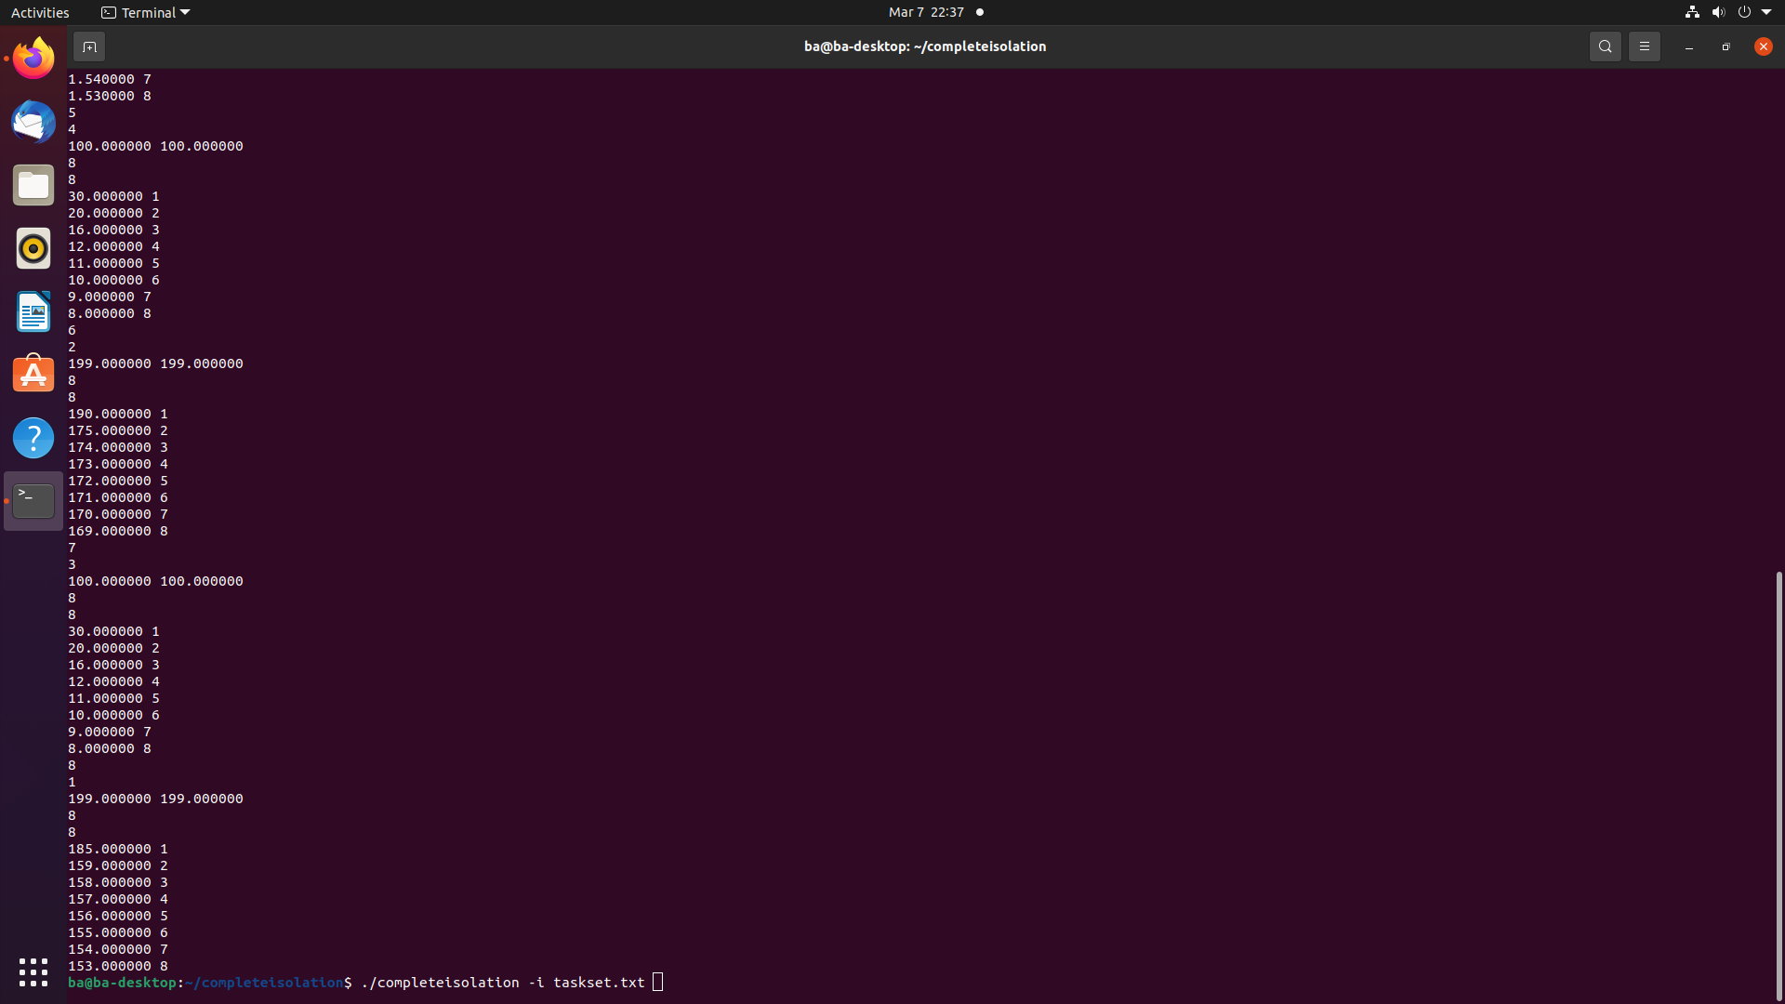

Slide 38
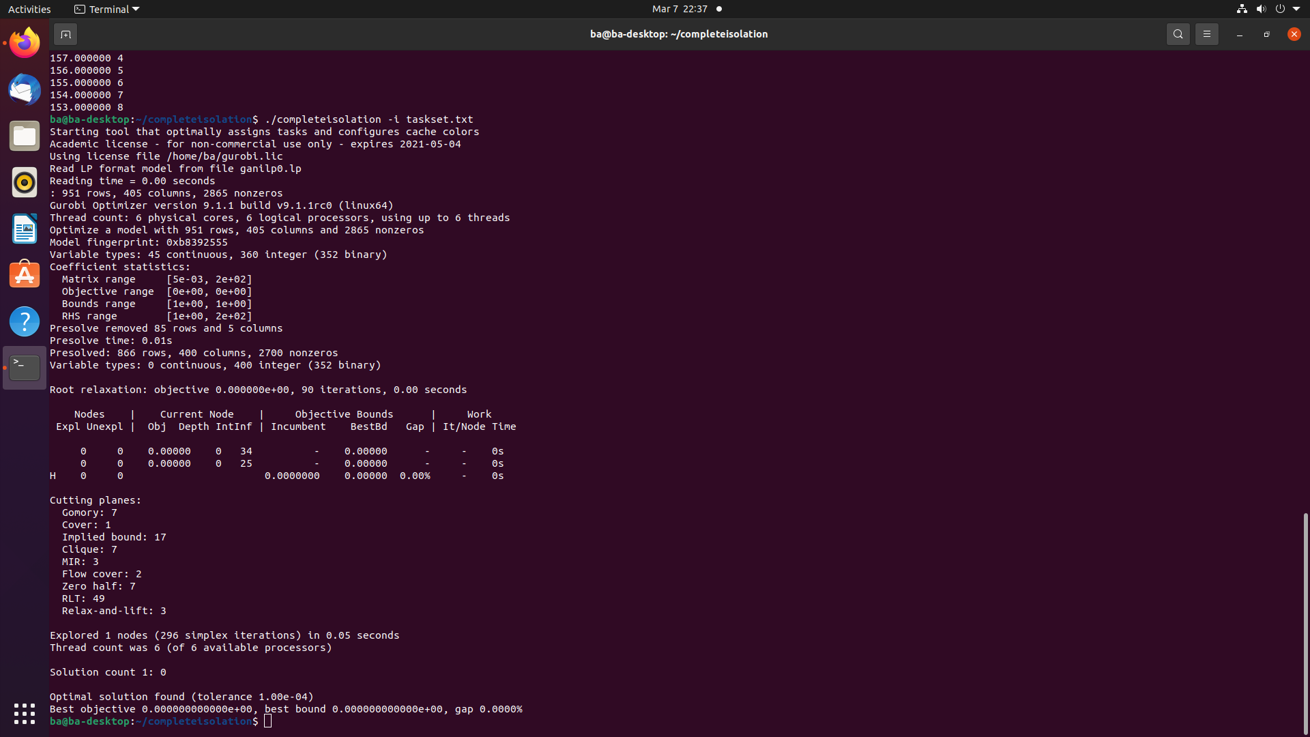

Slide 39
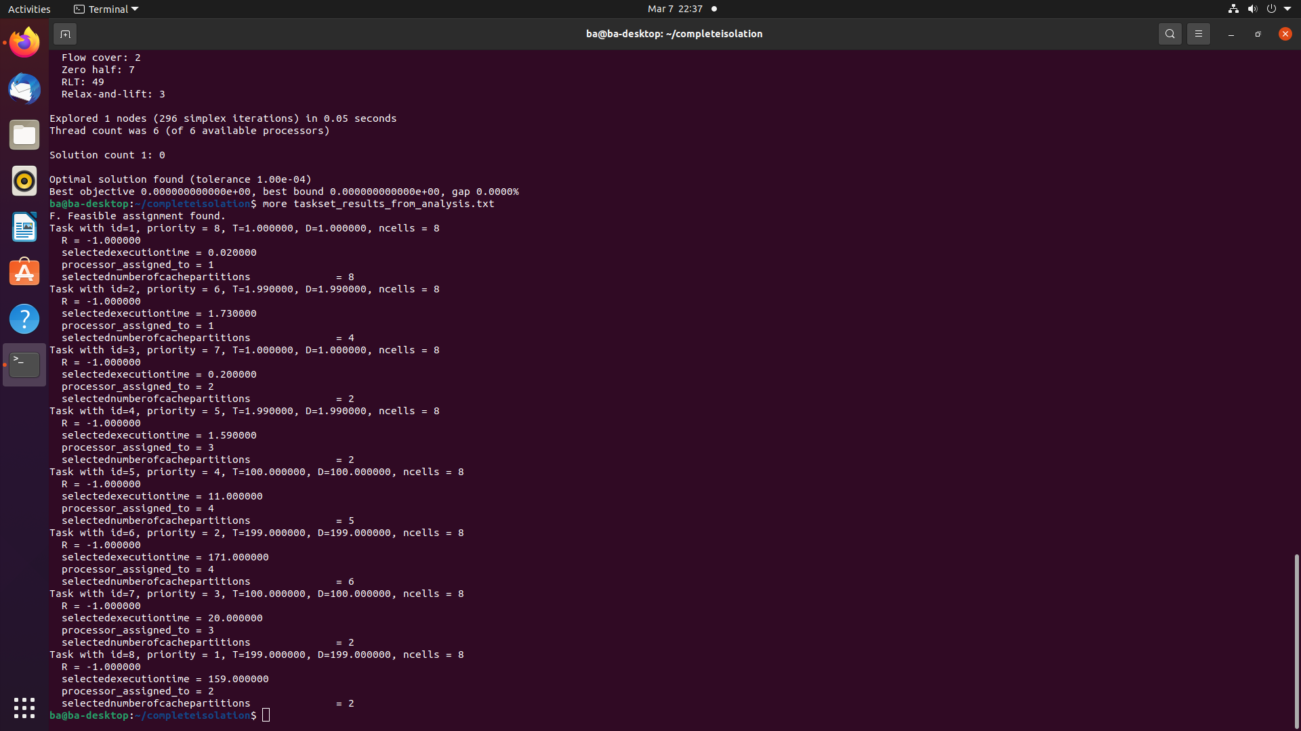

Slide 40
Potential use in a DevOps pipeline 1. In each thread/process, the source code needs to be modified to that before the thread/process starts execution, it reads from a text file to get information. With this information, it calls RK-functions to setup the coordinate cache and bank coloring and also assign it to processor core. Each thread/process has its own file that it reads from in order to get this info to pass to RK-functions. Each thread/process also has an associated file that describes parameters (e.g., period, execution time with different cache colors). 2. When “make” is run, a configuration preparation tool (not yet developed) is invoked. It gathers information about threads/processes from the aforementioned files and puts this info to a single file. This single file is input to the configuration tool (which we already have). Then the configuration tool generates the configuration to a file. A configuration effector tool (not yet developed) reads this file and writes to various files for each thread/process.

